Slide 1
Pong Game
Janabelle

Slide 2
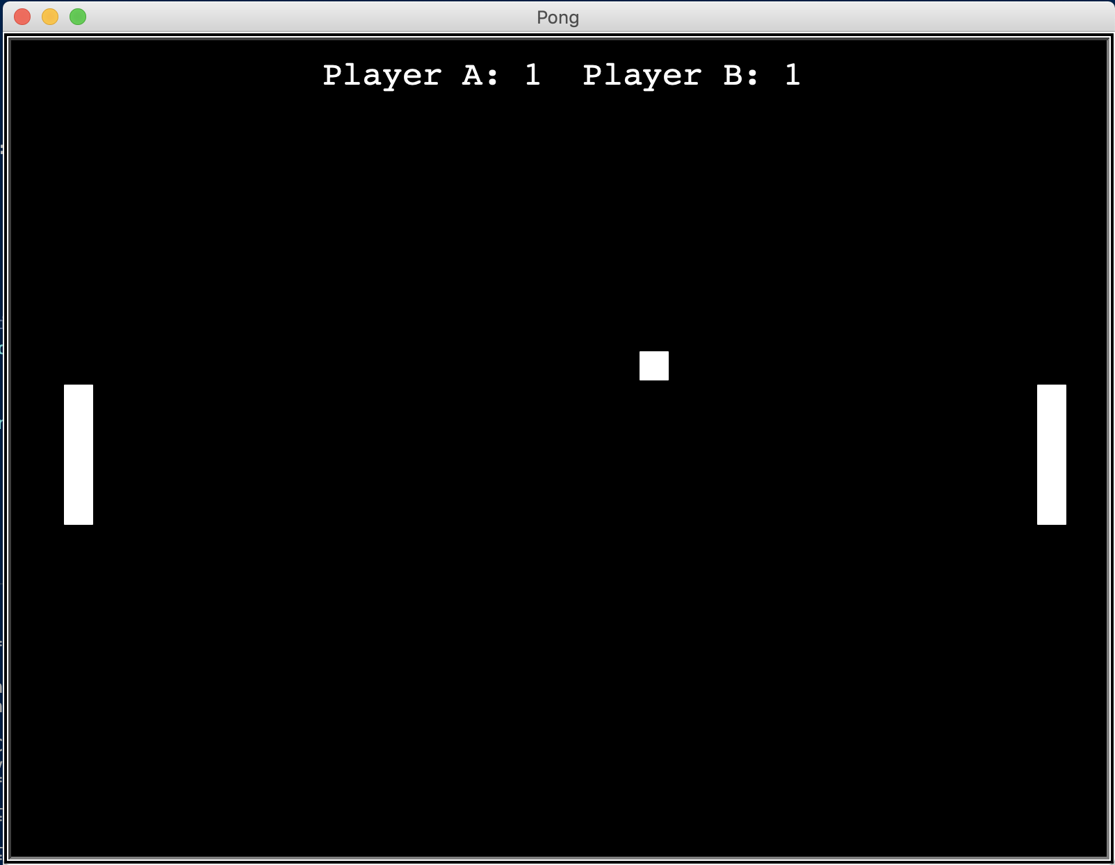
Demo!

Slide 3
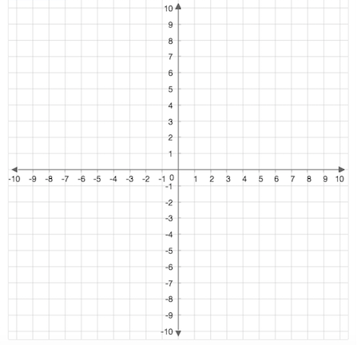
Turtle Graph

Slide 4
Turtle Paddles and Ball
Using turtle library, so include “import turtle” at the top of the file
paddle_a = turtle.Turtle()
Creating an object in the game
Do this four times, paddle_a, paddle_b, ball, pen
paddle_a.speed(0)
How fast it moves
In this case we want it to only move when we press buttons, so speed is 0
paddle_a.shape(“square”)
The object is a square
paddle_a.color(“white”)
The object’s color is white
paddle_a.shapesize(stretch_wid=5, stretch_len=1)
Changes the dimensions of the objects (changes it into a rectangle)
paddle_a.penup()
Pull the pen up, so no drawing when moving
paddle_a.goto(-350,0)
The position of the object

Slide 5
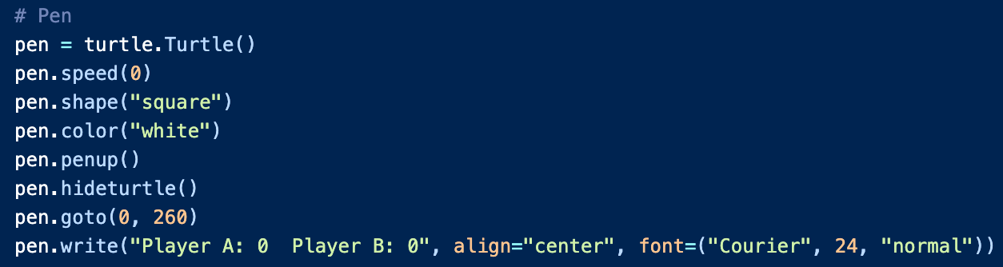
Turtle Text
Very similar to the slides before, but there are few new things
pen = turtle.Turtle()
If we set the text in the game as the variable pen
pen.hideturtle()
This makes your turtle invisible
pen.write(“text”)
This puts text at your object

Slide 6
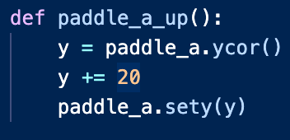
paddle_a_up()
paddle_a_down()
paddle_b_up()
paddle_b_down()
These functions are to move the paddles up or down depending on what key you press
paddle_a,ycor()
Gets the y coordinates of paddle_a
paddle_a.sety(y)
Move the object’s y coordinates to variable y

Slide 7
wn.listen()
wn.onkeypress()
wn.listen()
Makes sure the program is constantly listening or waiting for commands
Like key presses or mouse presses
wn.onkeypress(paddle_a_up, ‘Up’)
So when we press the up arrow, we will call the function that moves paddle_a up

Slide 8
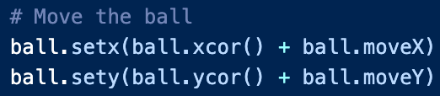
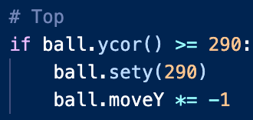
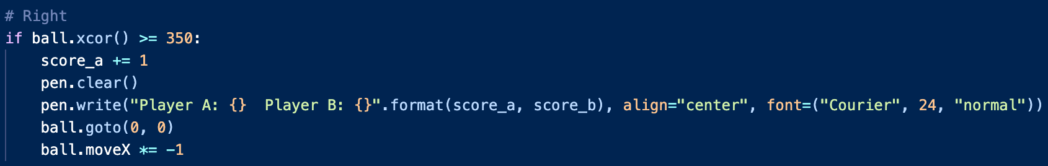
Main game loop
while True
We want the game to continue to run until the player stops it
How do we move the ball?
How do we check top and bottom border? What do we want the ball to do when it hits the top and bottom borders?
What about checking left and right?
We need to check two things. What are they?

